Slide 1

Electric Transportation Update
Community Energy Advisory Council
November 19th, 2010
Strictly no copying, forwarding or redistribution without permission from Progress Energy’s EIT Department; Emerging Technology & Alternative Energy Section.
Mike Waters
Advanced Transportation Manager
Progress Energy

Slide 2
Agenda
Value Proposition
Vehicle Technology
Charging Technology
Utility Role
Community Actions
Questions

Slide 3
Value Proposition
Key Issues
Electric Transportation as a Solution
Foreign oil dependency
60% US oil is imported
70% of all oil used for transportation
97% of transportation fueled by oil
Climate change/
air quality
Multiple studies confirm reduced CO₂ and improved air quality impacts from ET
Energy cost (transportation costs)
Fueling cost = 1/4 gasoline
$2-3 = 100 miles
Short-term gasoline market volatility
Jobs
Electric vehicle and related technologies can influence “green” jobs development

Slide 4
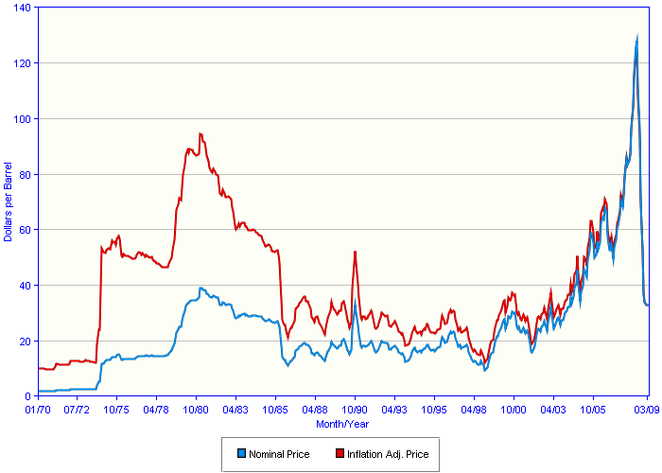
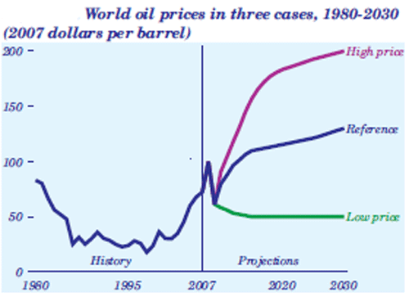
Managing Energy Costs
Key Point: Short-term market volatility likely. Future costs difficult to predict.
Projected Oil Price (AEO 2010)
Historical Costs
Oil Dependency Imposes Significant Costs on the US
Oil price spikes have contributed to every recent U.S. recession; according to the Department of Energy, oil
dependence has cost our economy $5 trillion since 1970 ($580 billion in 2008).
• According to the Rand Corporation, U.S. armed forces spend up to $83 billion annually protecting vulnerable
infrastructure and patrolling oil transit routes.
• Use of electricity for transportation could reduce cost to ¼ that of gasoline = savings of >$1125 / yr per vehicle
- assumes 12,000 miles per year per vehicle = 600 gallons of gasoline per year @ $2.50 per gallon

Slide 5
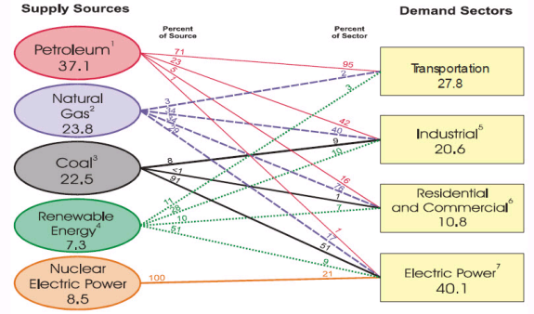
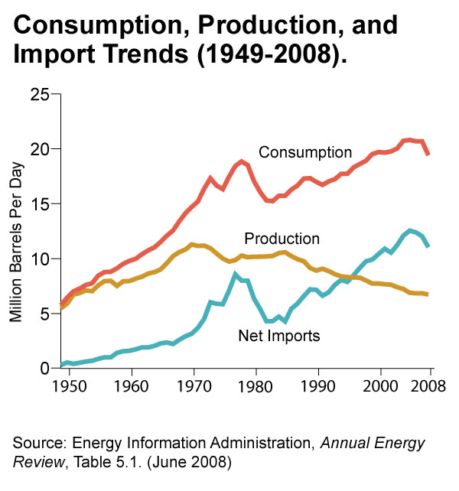

Promoting Energy Independence
Key Point: Electricity as a transportation fuel can significantly replace petroleum.
Foreign oil dependency:
60% of US oil is imported.
40% of US imports sourced from Persian Gulf, Venezuela, and Nigeria combined.
Electric Grid Capacity to Displace:
Pacific NW National Lab study indicated that current grid can handle 73% of today’s vehicles as plug-in hybrids , reducing oil imports by 50%

Slide 6

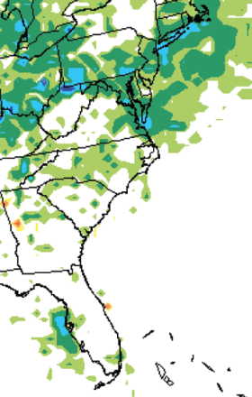
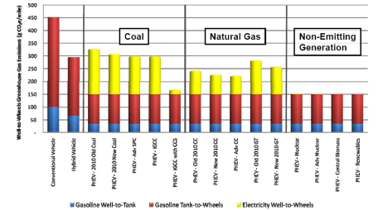
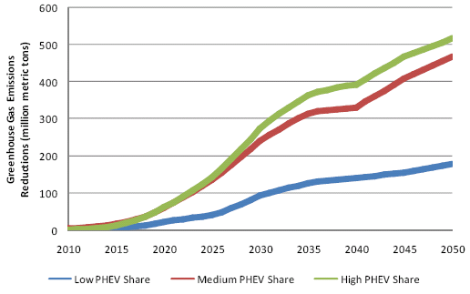
Helping Improve the Environment
Key Point: Net emissions are reduced with PEVs and can be further reduced with nuclear/renewables
CO2 (g) per Mile
CV vs. HEV vs. PHEV w/ Various Grid Sources
Cumulative Net CO2 reduction
Middle PHEV case
Annual 4th Highest 8-hr Ozone Difference (ppb): PHEV middle case vs. base case
Source: EPRI/NRDC 2007 Impact Study
6

Slide 7
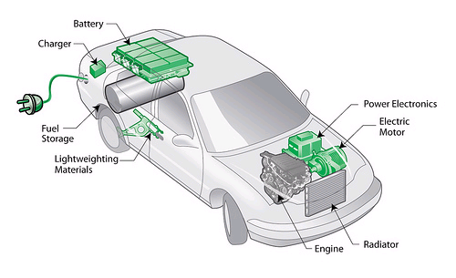
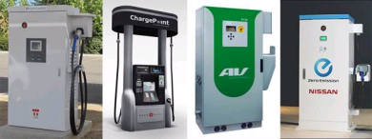
Potential Job Creation
North Carolina / Florida companies with plug-in electric vehicle technology capability
Smart metering and charging
- Elster
Consert
Car Charging Group, Inc
eLutions, Inc
FALCO Electronics
NovaCharge
Gasoline Equipment Systems
K&K Electric
Palmer Electric
Siemens Energy, Inc.
TLC Engineering
Dyer, Riddle, Mills, and Precourt, Inc
Vehicle Conversions
- AVRC in Raleigh
Hybrid Technologies (Mooresville)
Li-ion Motors (Charlotte)
Foreign Affairs Auto (PHEV retrofit)
GatorMoto
-PHEV Conversions (New Port Richey)
Secari Motor Company
World Class Exotics LLC
Grid hardware and charging infrastructure
- ABB
- Eaton
- SPX (Charlotte)
Schneider Electric
AMP Systems
Car Charging Group, Inc
Matern Professional Engineering, Inc
Palmer Electric
RubeLab
SunWise Power Systems
One World Sustainable
Batteries
- Celgard (Charlotte)
Blue Nano (Huntersville)
SAFT
Alegna Innovations, LLC
Precision Tool and Engineering
Planar Energy
ENER1
G4 Synergetics Corporation
US Lithium Energetics
Advanced electronics and chargers
- Delta Electronics (RTP)
Cree (RTP)
Eaton Cutler-Hammer
Electronic System Services, Inc. (ESSI)
EVnetics
Patco Electronics Inc
Solitron Devices Inc
Sussex Semiconductor, Inc
Major Vehicle Original Equipment Manufacturers (OEMs)
- Thomas-built for plug-in buses
- John Deere for tractors and heavy equipment
- Mac/Volvo for trucks
DesignLine for buses (Charlotte)
Avera Motors
Black Bay Technologies
Home Builders
Southern Traditions Development (Home tour stop for 2011 International Builders’s Show in Orlando. Intends to use EVSE as a one of the selling features in their green homes. Intend to demo PHEV or EV with home during show.)

Slide 8


The Stars are Aligning for Plug-ins to Succeed
Key Point: Although PEVs are not new, this time it is very different in terms of technology and marketplace
Technology
  Plug-in hybrid electric technology
  Improved batteries with higher energy density/longer range
Marketplace
  Driving factors include gas/oil prices, energy security, GHGs
  Not just California
  Broad support and incentives
Customer Features
  Instant torque
  Preconditioning the cabin
  Internet connected

Slide 9











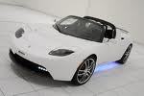












Key Trends; vehicle introduction
Key Point: Every automaker has a plug-in vehicle planned over the next 3 years.
PHEV or EREV
ALL ELECTRIC
Production
?
Chevrolet Volt
Toyota Prius
BYD 3DFM
Nissan Leaf
Smart ED
Mitsubishi iMIEV
Mitsubishi PX-MiEV
BMW Concept
VW Golf
TwinDrive
Ford Focus
Ford Transit
Connect
Tesla
Demo/Concept
Hyundai Blue-Will
Volvo C30
Kia Ray
Chrysler/Fiat EV
Honda Fit EV
Toyota RAV4 EV
GM PHEV (?)
Cadillac Converj
Fisker Karma
Mercedes BlueCell
Tesla Model S
Toyota FT-EV

Slide 10
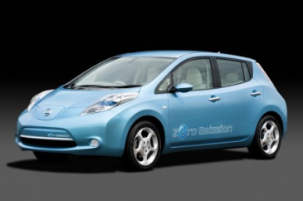
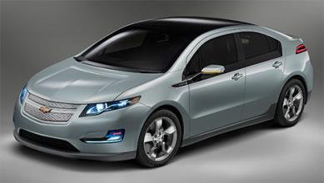
GM and Nissan Update
 | Chevrolet Volt | Nissan Leaf
Launch date | November 2010 | December 2010
MSRP / tax credit | $41,000 / 7,500 | $32,800 / 7,500
Lease details | $350/month, $2,500 down, 36 months | $350/month, $2,000 down, 36 months
Initial production # | 10,000 (2011), 45,000 (2012) up to 60,000 capacity | Up to; 50,000 (Japan, 2011), 150,000 (TN, 2012), 50,000 (UK, 2013)
Type / # seats | Sedan / 5 | Sedan / 5
EV (IC engine) range | 40 (260) | 100 (NA)
IC engine Electrical motor | Gas / 1.4 liter / 53 kW 111 kW | N/A 80 kW / 280 Nm
Battery capacity | 16 kWh | 24 kWh
Battery type | Li-ion, 250 cells | Laminated Li-ion
Charge time (120/240V) | 8/3 hrs | 16/8 hrs
Battery weight (lbs) | 375 | 440
Nissan Leaf
Chevy Volt

Slide 11
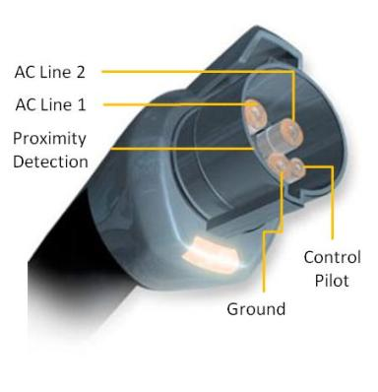
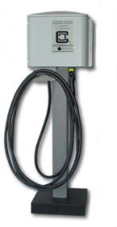

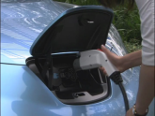
Key Trends; charging standards
Key Point: The industry has agreed up upon a single charging connection standard – SAE J1772
 | Voltage | Max Current | Likely Current | Charge Time (average) | Charge Time (full charge BEV) | Reference
AC Level 1 | 120 V | 16 A | 12 A | 8-12 hrs | 16-20 hrs | Hair Dryer
AC Level 2 | 208/240 V | 80 A | 16-30 A | 2-3 hrs | 6-8 hrs | Clothes Dryer
DC Fast | Under development; target 80% complete charge in 10-25 minutes (500V, 100A, 50 kW) |  |  |  |  | Small Building
Provider | Level 2 | DC Fast Charge | EVSE Supply Agreements
AeroVironment | EVSE-RS | In development | Nissan
Clipper Creek | CS-30 – CS-100 product range | n/a | Tesla, BMW trial
GE | WattStation | In development
SPX | EVSE Product | n/a | GM (install)
Eaton | Pow-R-Station | Available | Mitsubishi
Coulomb | ChargePoint | Available
Level 1 can utilize a standard household outlet and stand alone cord set, but Level 2 requires a hardwired cord set into a special box with safety electronics.

Slide 12
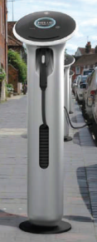
Key Trends; charging infrastructure details
Key Point: Technology is in rapid development with various options
Electric Vehicle Supply Equipment (EVSE) functionality
  Basic: Safety appliance incorporating customer operability
  Smart: Additional control, access, measurement, and billing options
EVSE sourcing options
  Dealer option
    Level 1 included with vehicle purchase
    Level 2 option (basic)
      Option for purchase/lease unit with vehicles
  3rd Party option
    Independent companies with multiple EVSE options, including network management, access control, energy measurement, etc.
  Utility option
    Under consideration nationwide

Slide 13
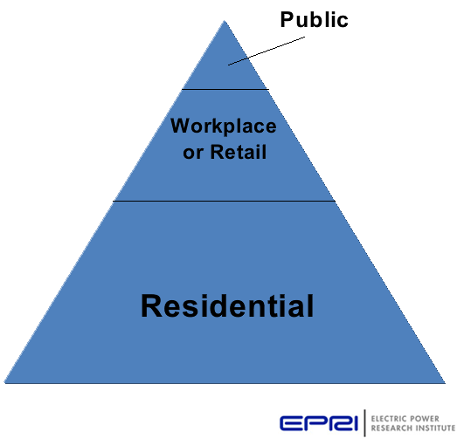
Key Trends; charging locations
Key Point: Charging infrastructure is critical; majority will occur at home
Residential
  Default charging
  AC Level 1 or 2
  $500-2,000 hardware (L2)
  $500-$1,500+ installation
Workplace/Retail
  2nd most common location
  AC Level 2
  $2,000-8,000 hardware
  Similar range for installation
Public
  Retail, decks, curbside
  AC Level 2, DC Fast
  Similar costs for workplace (L2)
    DC Fast Charging unknown

Slide 14
Key Trends; integration of plug-in vehicles into the future grid

Slide 15
Key Trends; electric utility role
Key Point: As the new transportation fuel provider, the utility will play an important role in maintaining grid reliability and safety, managing system costs, and ensuring a positive customer experience
Focus Areas:
1 Infrastructure | 2 Customer Support | 3 Customer and Stakeholder Education | 4 Vehicle and Infrastructure incentives | 5 Utility Fleets
Address potential system grid impacts and help develop local charging infrastructure | Implement a robust process to support PEV requests and streamline charging installs | Collaborate with stakeholders to implement broad education program regarding PEVs | Work with stakeholders to develop vehicle and infrastructure incentives | Develop fleet acquisition and operations plan to incorporate plug-in drive technology
On October 21, 2009 Progress Energy joined with its peer investor-owned electric utilities in a national pledge to help create the infrastructure to support the full-scale commercialization and deployment of plug-in electric vehicles (PEVs). The pledge builds on existing actions to help prepare the market for full-scale commercialization and deployment of PEVs by aggressive action in five focus areas. Progress Energy’s Electric Transportation Strategy supports the EEI pledge and the key elements are summarized below:

Slide 16
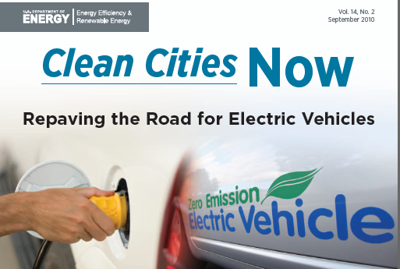




Key Trends; communities getting ready for electric transportation
Key Point: Communities are working together to address barriers and enable electric transportation
Preparing for and enabling electric vehicles is a national priority
DOE, Clean Cities, national labs, ARRA funding, tax credits
States, regions, and cities are forming local “Project Get Ready” initiatives to:
Convene a diverse stakeholder group
Examine local barriers related to electric transportation
Develop strategic solutions
Educate, communicate, and share best practices

Slide 17
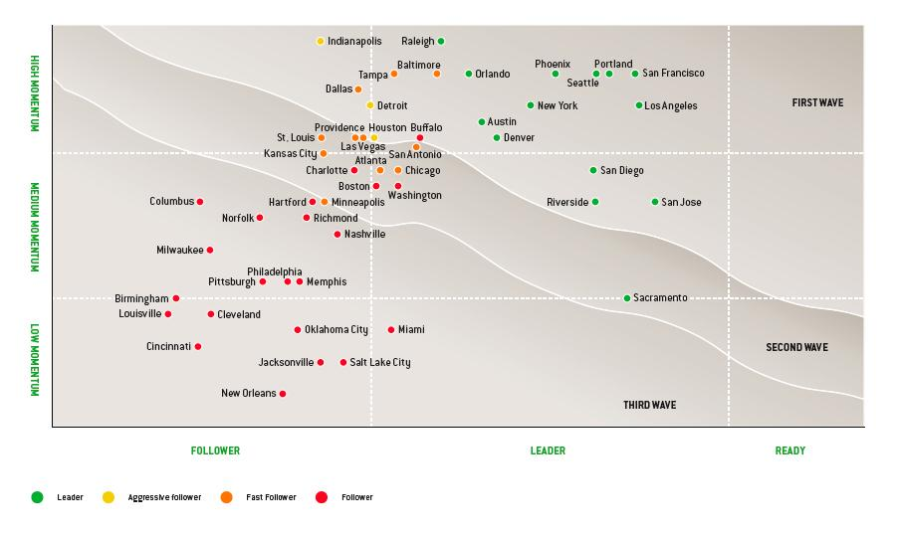
Key Trends; communities getting ready for electric transportation
Source: Electric Vehicles in America, Roland Berger Strategy Consultants and Rocky Mount Institute’s Project Get Ready. The study assesses the following key requirements for PEV readiness, including:
Regulatory Environment
Infrastructure Readiness
Consumer Readiness
Operating Environment

Slide 18
Final Thoughts
Plug-in vehicles are real and coming this year
On/off road electric transportation can improve air quality while reducing GHG and petroleum use
Grants and tax credits available:
  Up to $7,500 credit on light duty vehicles; 50% on infrastructure
  Multiple grant funding opportunities for infrastructure
Consider fuel, maintenance savings and EPAct credit for vehicles
Assess your needs and identify the best technology
Many processes, codes, and regulations will be impacted
  Start evaluating this prior to “crunch” time
North Carolina is leading the way

Slide 19


Strictly no copying, forwarding or redistribution without permission from Progress Energy’s EIT Department; Emerging Technology & Alternative Energy Section.
Questions?

